Slide 1
YCFC&WCD BOARD OF DIRECTORS December 6, 2022

Slide 2
Agenda Item #1 Adoption of the November 1, 2022 Regular Board Meeting Minutes

Slide 3
Agenda Item #2 Open Forum Guest introductions, unscheduled appearances and opportunity for public comment on non-agenda items

Slide 4
Agenda Item #3 Adding Items to the Posted Agenda

Slide 5
Agenda Item #4 Receive Update from Outreach Committee on District’s Implementation of an Alternative Funding Mechanism

Slide 6
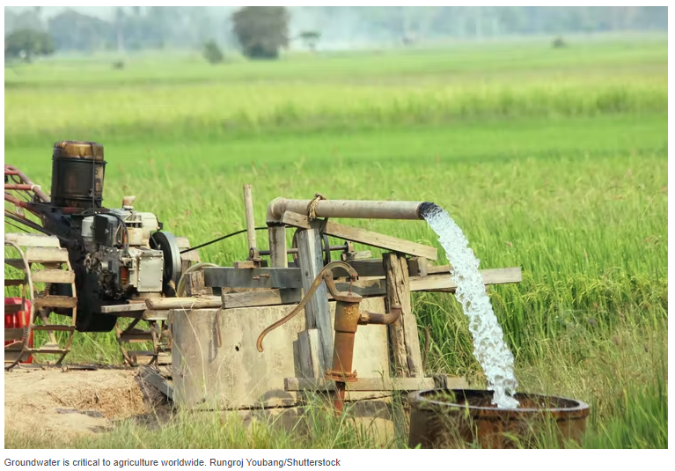
Plan to Recover Infrastructure Funds & Stabilize District Finances

Slide 7
Recommended Funding Structure
Improve revenue stability through three-prong structure:
Fixed annual standby charge on property that can receive water from the District
Baseline revenue to align with annual costs incurred regardless of water supply conditions
Variable water rate fee based on current rate structure
Variable revenue aligned with variable expenses to deliver water
Groundwater charge
In-lieu, active, and passive recharge benefits
*NOTE: Rates are for qualitative comparison; range has not yet been determined.

Slide 8
Outreach Committee Update
November 10 – First Focus Group Meeting
December 13 – Second Focus Group Meeting
Save-the-date: January 11 at 6 p.m.: First Public Outreach Meeting

Slide 9
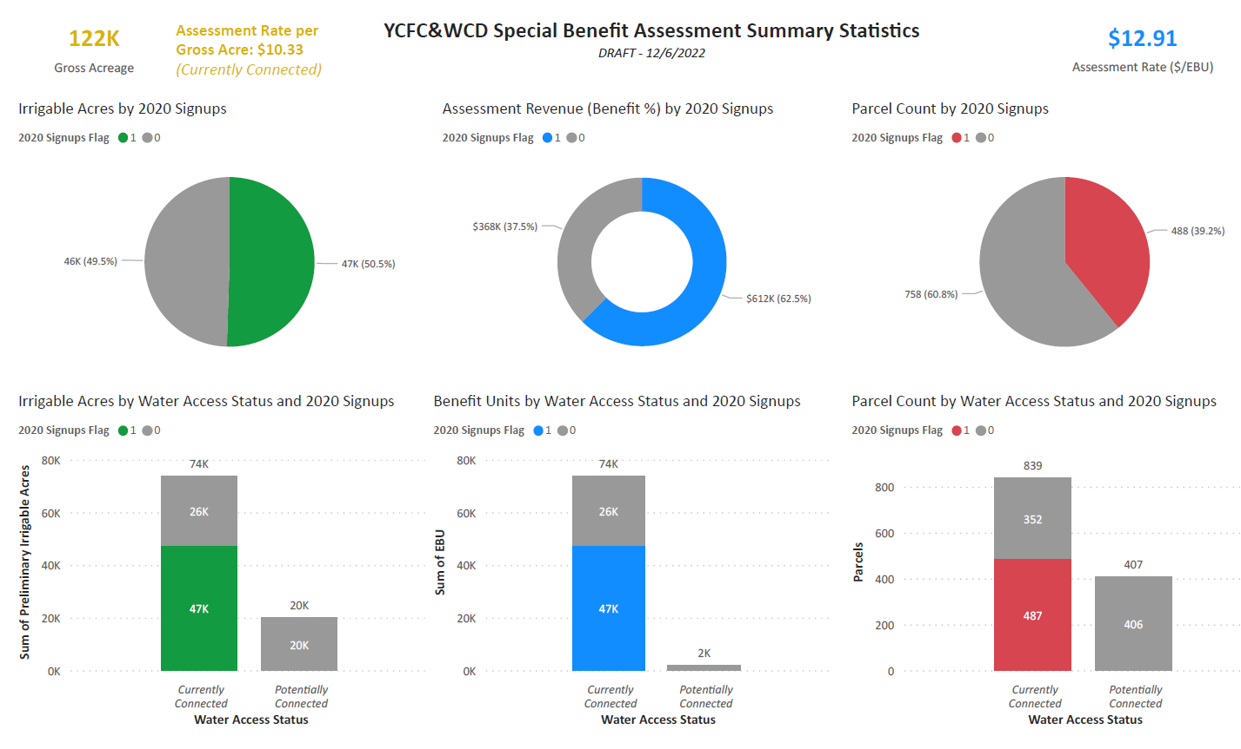
DRAFT

Slide 10
Updated Schedule – Phase 2
January 3, 2022: Presentation on Preliminary Engineer’s Report
BOD Resolution of Prop. 218 Procedures
BOD Adopt Resolution of Intention
BOD Set Public Hearing for Special Benefit Ballot Tabulation (March 7, 2022)

Slide 11
Updated Schedule – Phase 2
January 3, 2022: Presentation on Preliminary Engineer’s Report
BOD Resolution of Prop. 218 Procedures
BOD Adopt Resolution of Intention
BOD Set Public Hearing for Special Benefit Ballot Tabulation (March 7, 2022)
January 11-February 25, 2022: Special Benefit Balloting Period
January 11 and January 25 public outreach meetings

Slide 12
Updated Schedule – Phase 2
January 3, 2022: Presentation on Preliminary Engineer’s Report
BOD Resolution of Prop. 218 Procedures
BOD Adopt Resolution of Intention
BOD Set Public Hearing for Special Benefit Ballot Tabulation (March 7, 2022)
January 11-February 25, 2022: Special Benefit Balloting Period
January 11 and January 25 public outreach meetings
March 7, 2022: Public Hearing for Assessment Adoption Determination
Tabulate ballots and certify results
Presentation of Draft COS Study (w/ or w/o assessment)
BOD Acceptance of COS Study
BOD Set Public Hearing for Setting New Volumetric Rate (May 1, 2022)

Slide 13
Updated Schedule – Phase 2
January 3, 2022: Presentation on Preliminary Engineer’s Report
BOD Resolution of Prop. 218 Procedures
BOD Adopt Resolution of Intention
BOD Set Public Hearing for Special Benefit Ballot Tabulation (March 7, 2022)
January 11-February 25, 2022: Special Benefit Balloting Period
January 11 and January 25 public outreach meetings
March 7, 2022: Public Hearing for Assessment Adoption Determination
Tabulate ballots and certify results
Presentation of Draft COS Study (w/ or w/o assessment)
BOD Acceptance of COS Study
BOD Set Public Hearing for Setting New Volumetric Rate (May 1, 2022)
May 1, 2022: Presentation on Final Cost-of-Service Study
BOD Adopt and Publish New Water Rates

Slide 14
Agenda Item #5 Directors’ Reports Report on Meetings and Conferences Attended During the Prior Month on Behalf of the District i. Outreach Committee Meeting with Focus Group (November 10) ii. ACWA Fall Conference (November 28-December 1) iii. NCWA Board Meeting and Groundwater Meetings, Winter Water Rights Committee Meeting and Meeting with Karla Nemeth to Discuss VA Conceptual Proposal and (November 2, 10, 17, and 21)

Slide 15
Agenda Item #6 Attorney’s Reports Report on Legal Matters of Concern to the District
Annual BKS New Laws Report

Slide 16
Agenda Item #7 General Manager’s Report
Water Conditions Report
Financial Report Summary
Capital Improvement Program
General Activities
YSGA Update
Upcoming Events

Slide 17
Current Water Conditions (12-06-22)
Elevation Available 2021
Clear Lake
December 6 -2.51’ 0 AF -1.38’ (0 AF)
November 6 -2.62’ 0 AF
Total Gain 0.11’ 0 AF
Indian Valley Reservoir
December 6 1,389.10’ 44,160 AF 1,368.97’ (24,480 AF)
November 6 1,389.52’ 44,650 AF
Total Loss -0.42’ -490 AF

Slide 18
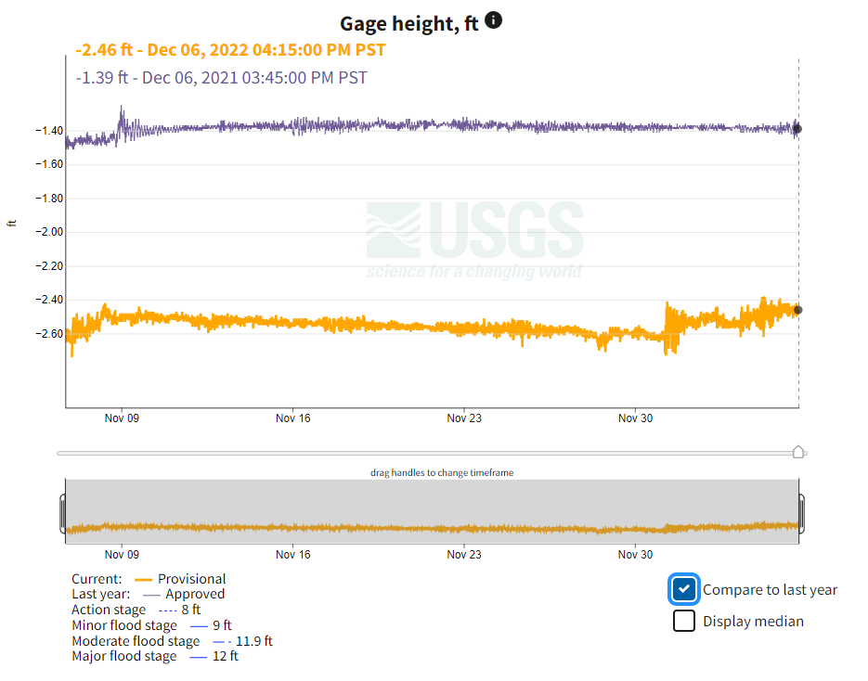
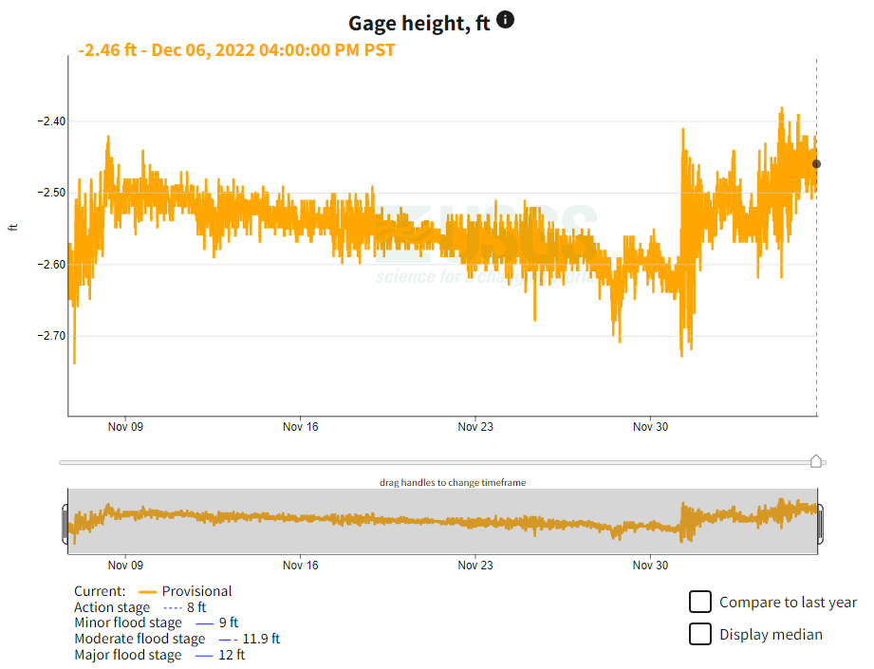
Clear Lake elevation
30-day summary
Comparison to last year

Slide 19
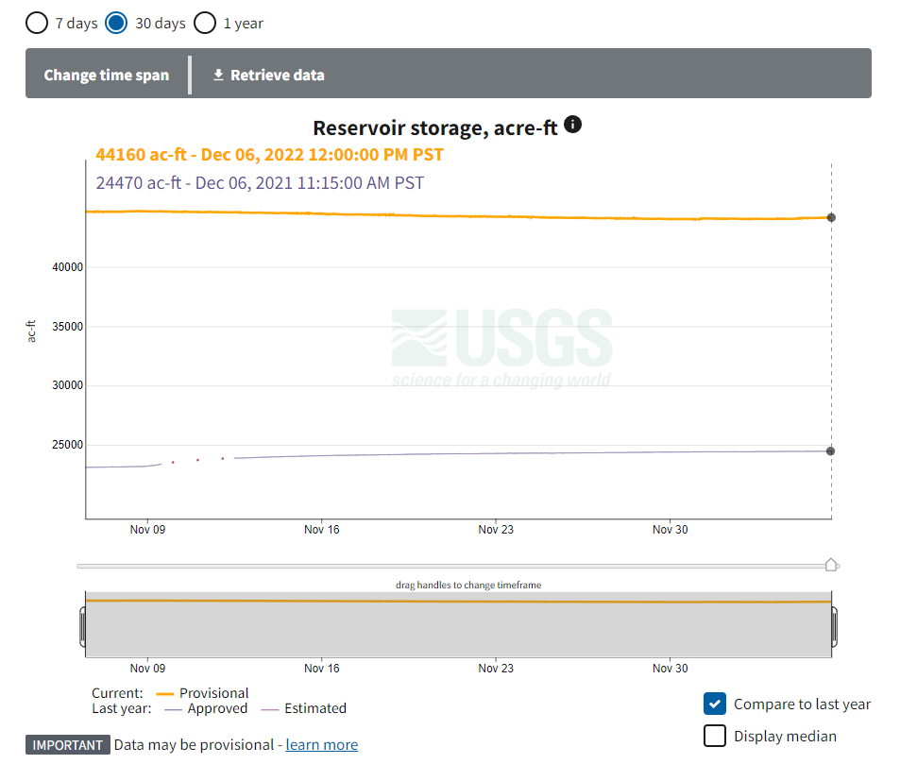
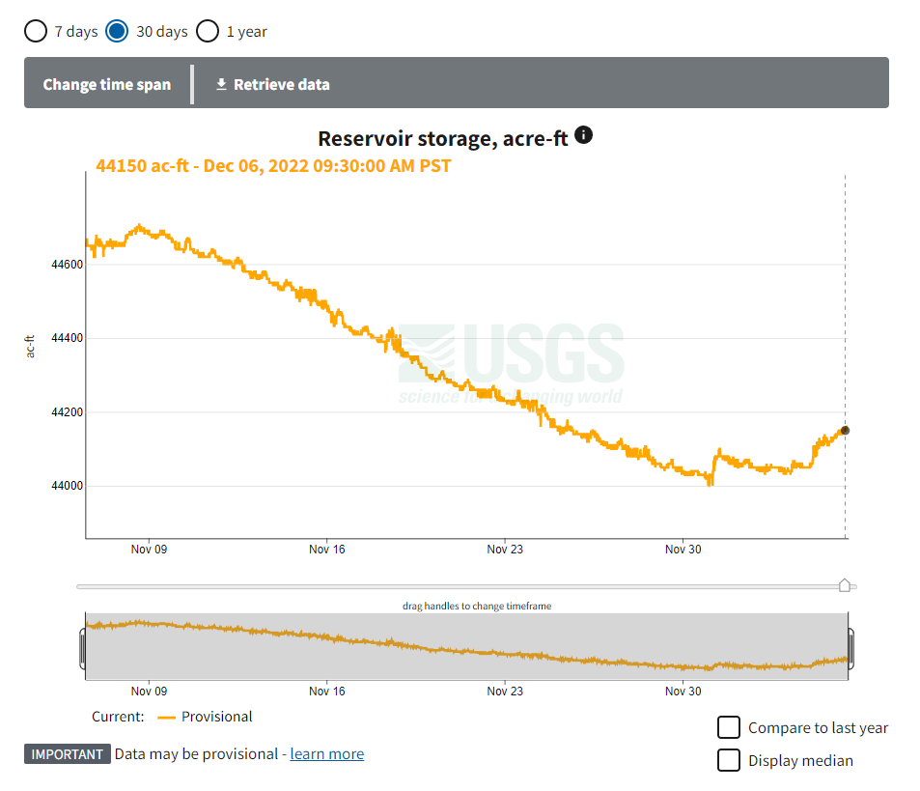
Compared to last year
30-day summary
Indian Valley Reservoir storage

Slide 20
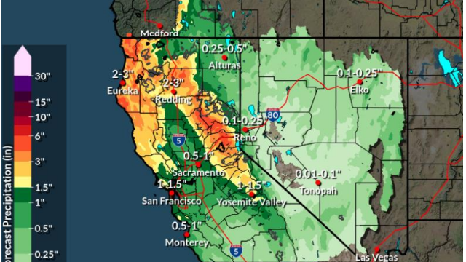

Slide 21
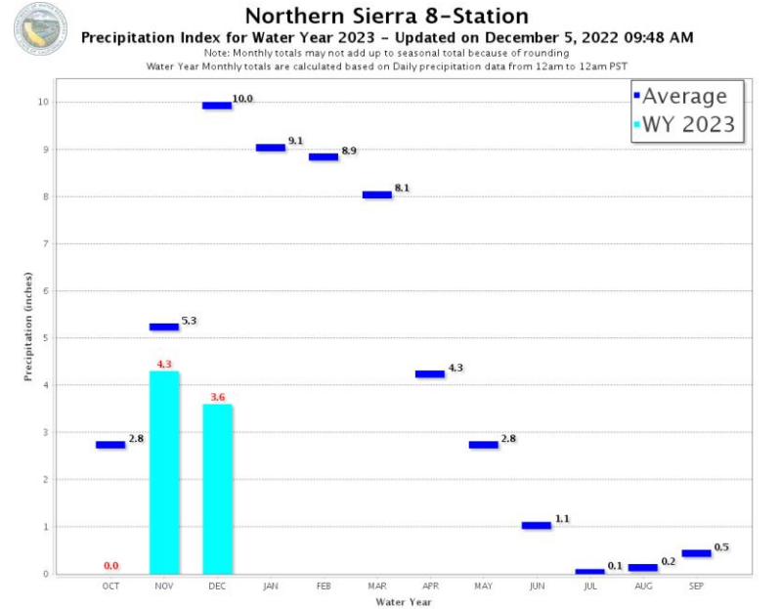

Slide 22
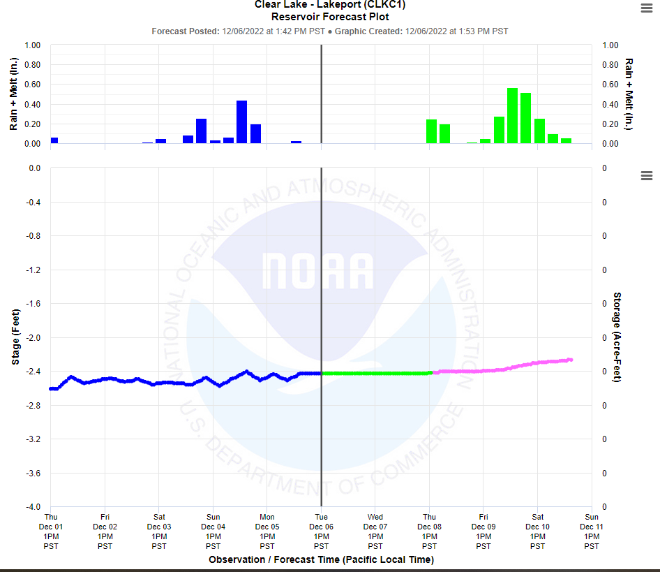

Slide 24
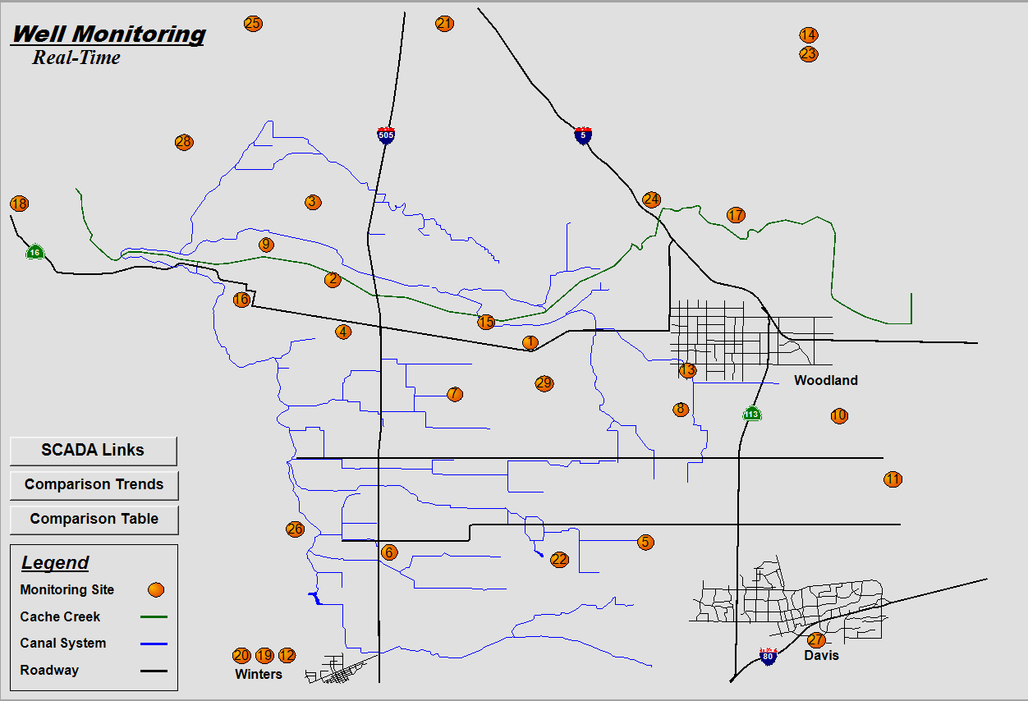

Slide 25
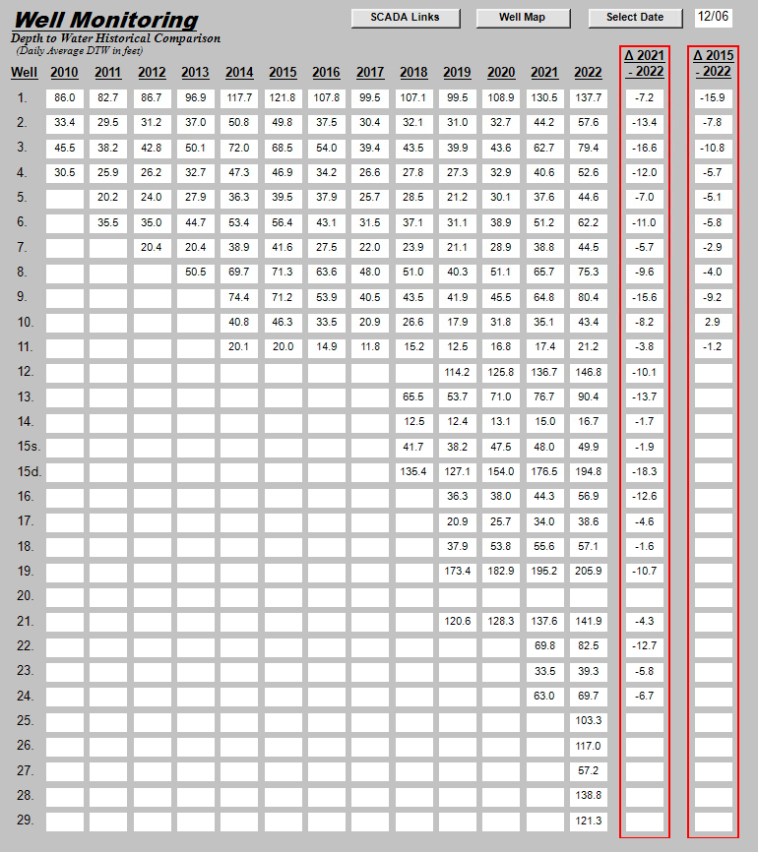
------ Working on a replacement -----
Notes:
9 feet lower than last year and 6 feet lower than 2015

Slide 26
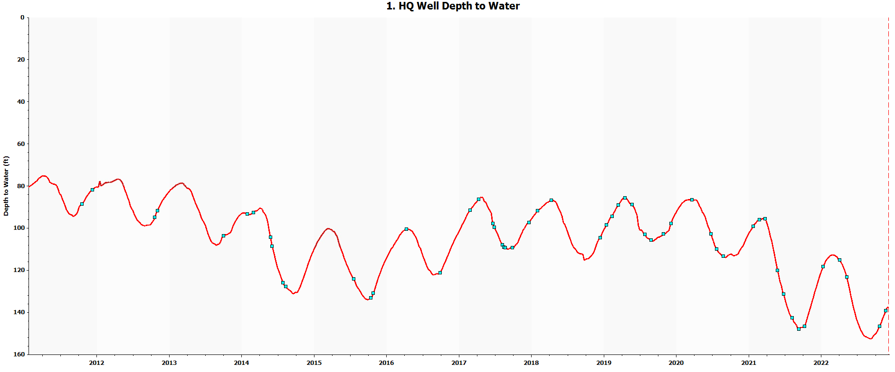
Depth to Water
11/6/21: 140.4 feet
12/6/21: 130.5 feet
Δ 9.9 feet
Depth to Water
11/6/22: 145.1 feet
12/6/22: 137.7 feet
Δ 7.4 feet

Slide 27
https://www.latimes.com/environment/story/2022-12-06/a-minnow-sacred-to-some-native-americans-nears-extinction

Slide 28
Preliminary Financial Report
Highlights as of November 30, 2022

Slide 29
Preliminary Budget Summary as of 11/30/2022
Key Revenue Drivers | Year-to-Date | Budget | Difference
Agricultural Water Sales | $68,100 | $84,500 | ($16,400)
Non-Agricultural (M&I) Water Sales | $146,400 | $334,200 | ($187,800)
Property Taxes | $194,800 | $1,657,600 | ($1,462,800)
IV Dam Hydro (less fees) | $0 | $0 | $0
Other Revenue | $644,600 | $716,000 | ($71,400)
Shared Services Revenue | $376,900 | $300,000 | $76,900
YSGA Reimbursements | $123,400 | $275,000 | ($151,600)
Interest | $38,000 | $20,000 | $18,000
Other | $106,300 | $121,000 | ($14,700)
TOTAL REVENUE | $1,053,900 | $2,792,300 | ($1,738,400)
Key Expense Drivers | Year-to-Date | Budget | Difference
Transmission and Distribution (O&M) | $450,600 | $1,060,200 | ($609,600)
General Administration | $1,401,300 | $2,147,200 | ($745,900)
Other Expenses | $1,737,900 | $2,652,700 | ($914,800)
TOTAL EXPENSES | $3,589,800 | $5,860,100 | ($2,270,300)

Slide 30
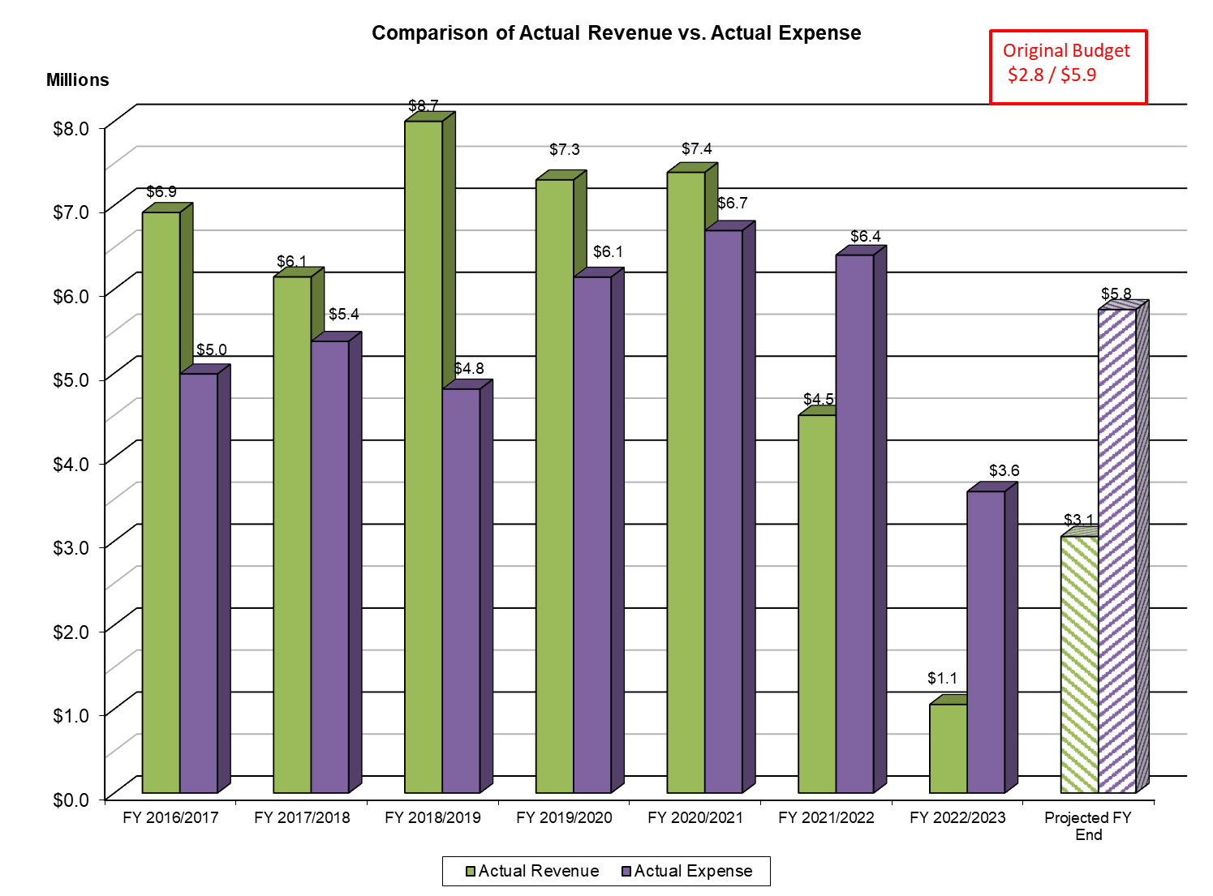
Preliminary Financial Report

Slide 31
Preliminary Financial Report
FY 15/16
$4.6M
FY 15/16
$4.4M
FY 21/22
FY 14/15
$3.7M
FY 14/15
$2.8M

Slide 32
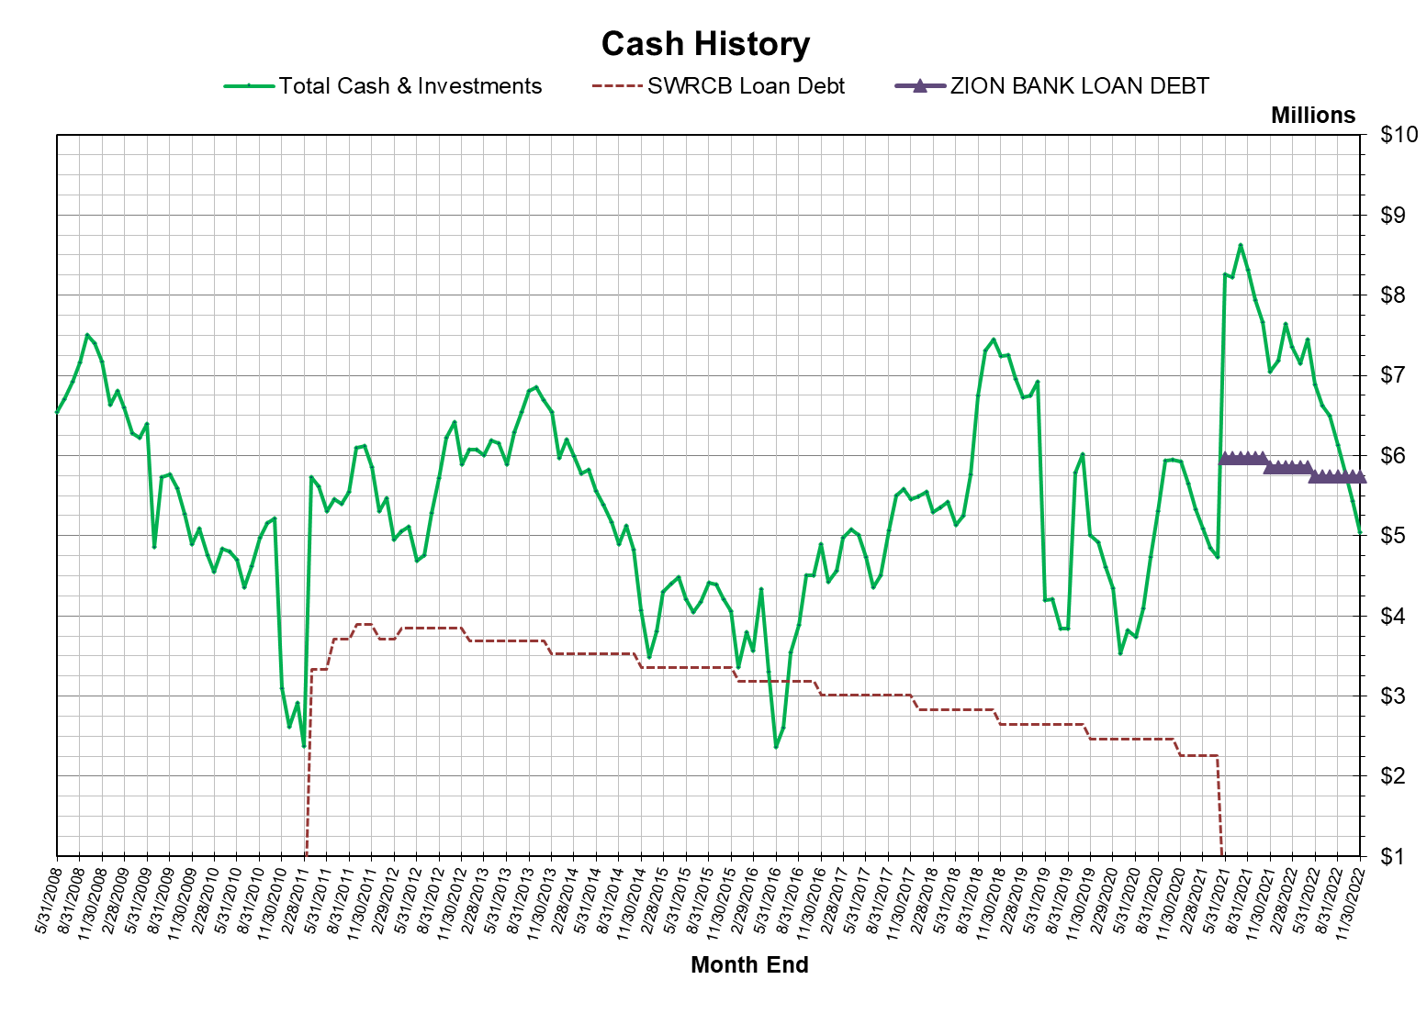
Preliminary Financial Report

Slide 33
Capital Improvement Program

Slide 34
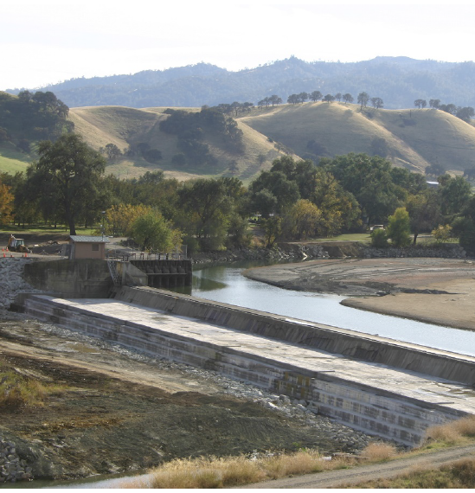
Planning for Capital Jobs
Capay Dam Bladder Replacement Project
FY 22/23 Planning Activities Related to Large Capital Jobs
Hungry Hollow Canal – Pipeline Extension Project

Slide 35
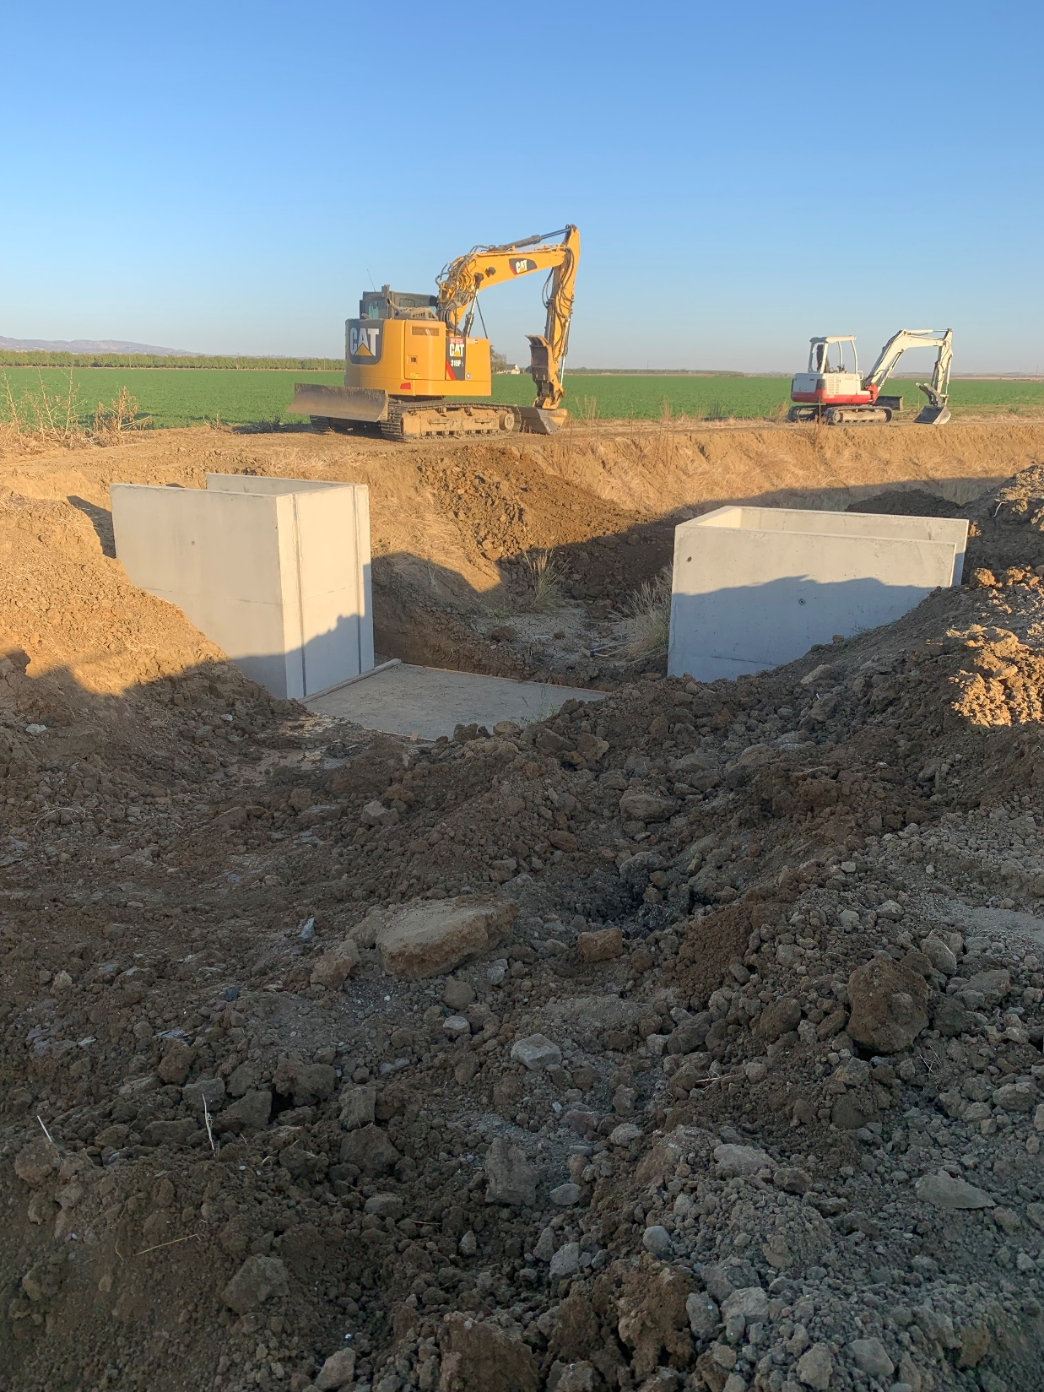
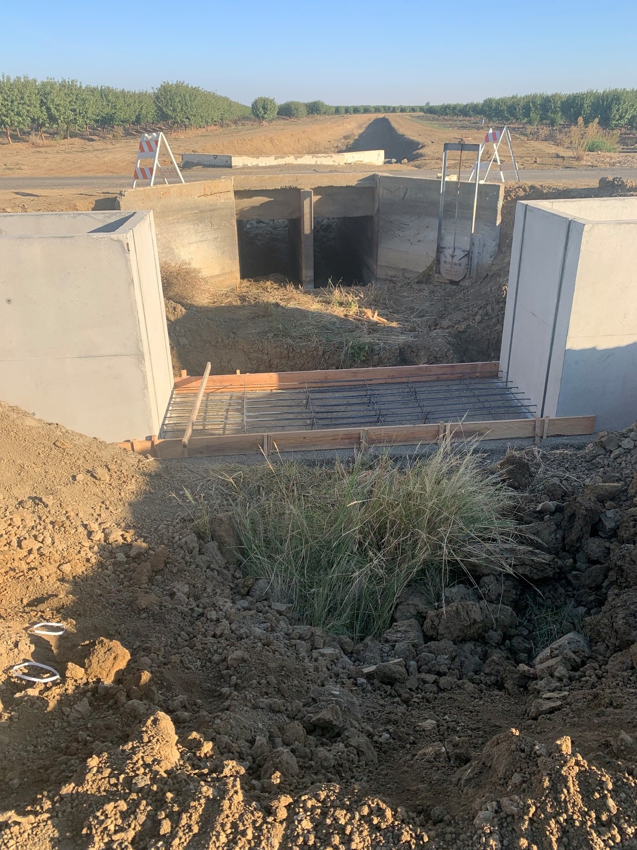
Hungry Hollow Canal Check Relocation and Enhancement (HUH0263)

Slide 36
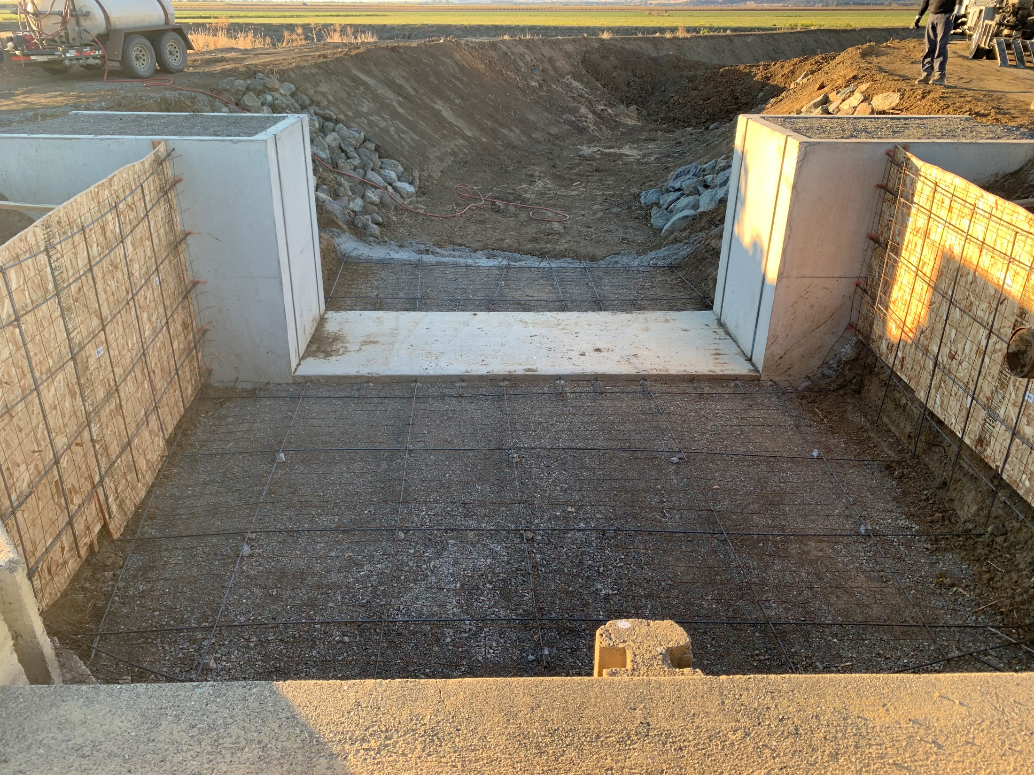
Hungry Hollow Canal Check Relocation and Enhancement (HUH0263)

Slide 37
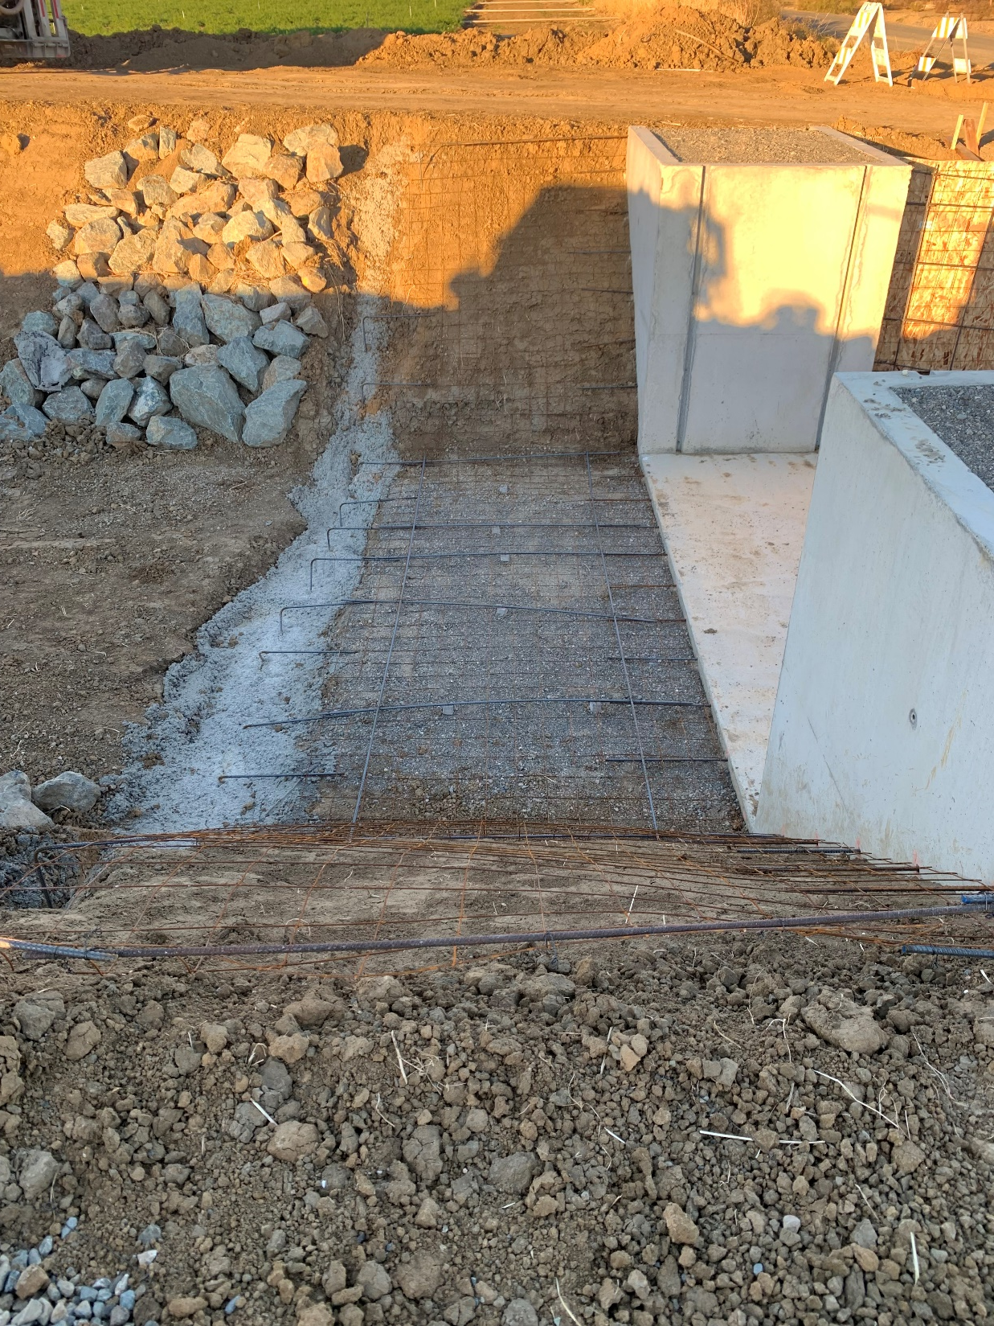
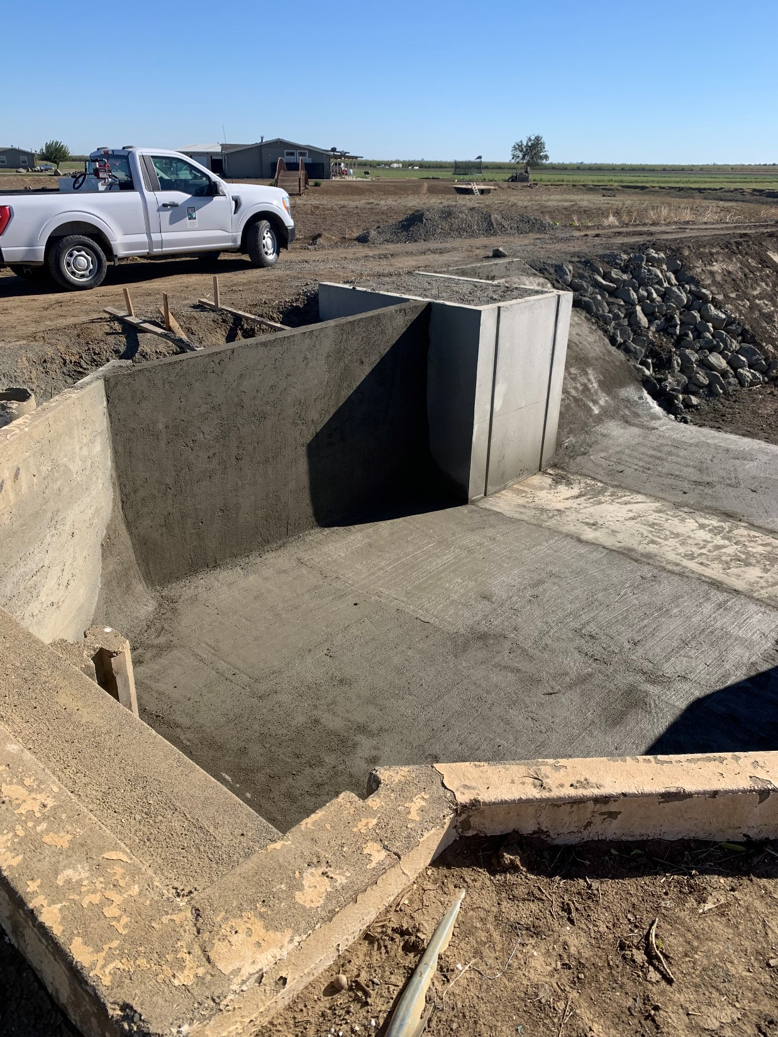
Hungry Hollow Canal Check Relocation and Enhancement (HUH0263)

Slide 38
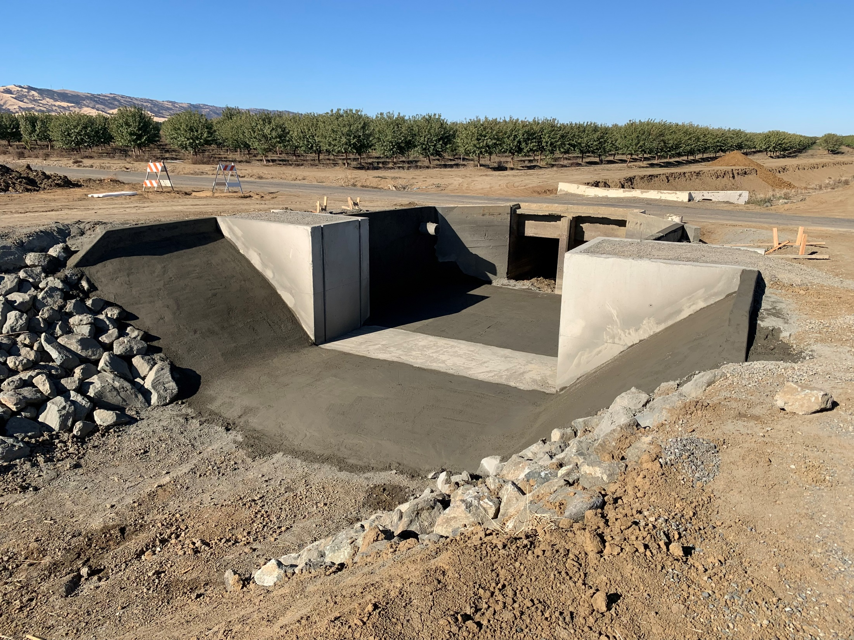
Hungry Hollow Canal Check Relocation and Enhancement (HUH0263)

Slide 39
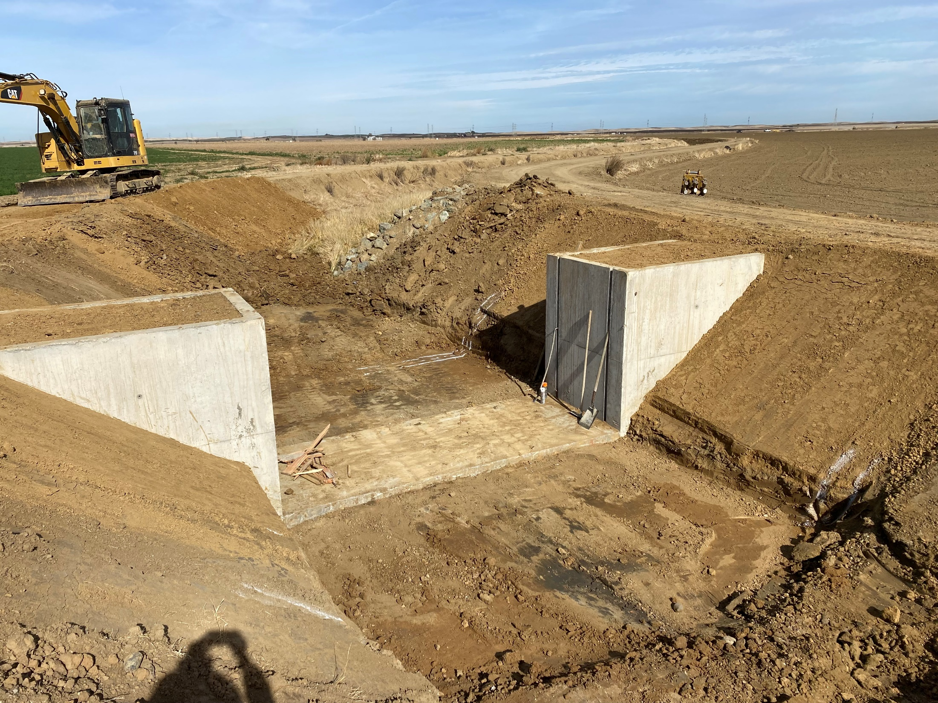
Hungry Hollow Canal Check Relocation and Enhancement (HUH0391)

Slide 40
Discussion of FY 22/23 Planning Activities Related to Large Capital Jobs
Indian Valley Reservoir – 60” Hollow-Jet Valve Rebuild: ~$200k
FERC Part12D Recommendations
Photogrammetric Topo Survey of Eastern Ravine: ~$30k
Potential Failure Mode Analysis Investigations: ~$100k
Spillway Repair Project: ~$300k (FY 23/24)
Dam Seepage Monitoring: ~$500k (FY 23/24, maybe pushback)
Penstock and Spillway Gates Recoating Project: ~$800k (FY 24/25)

Slide 41
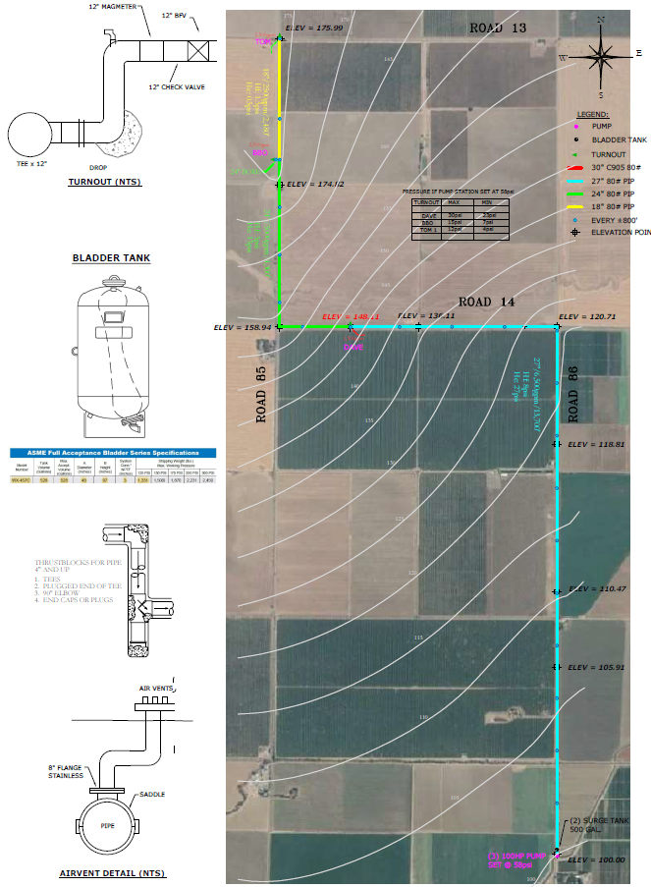
Update on Hungry Hollow Canal Pipeline Extension Project

Slide 42
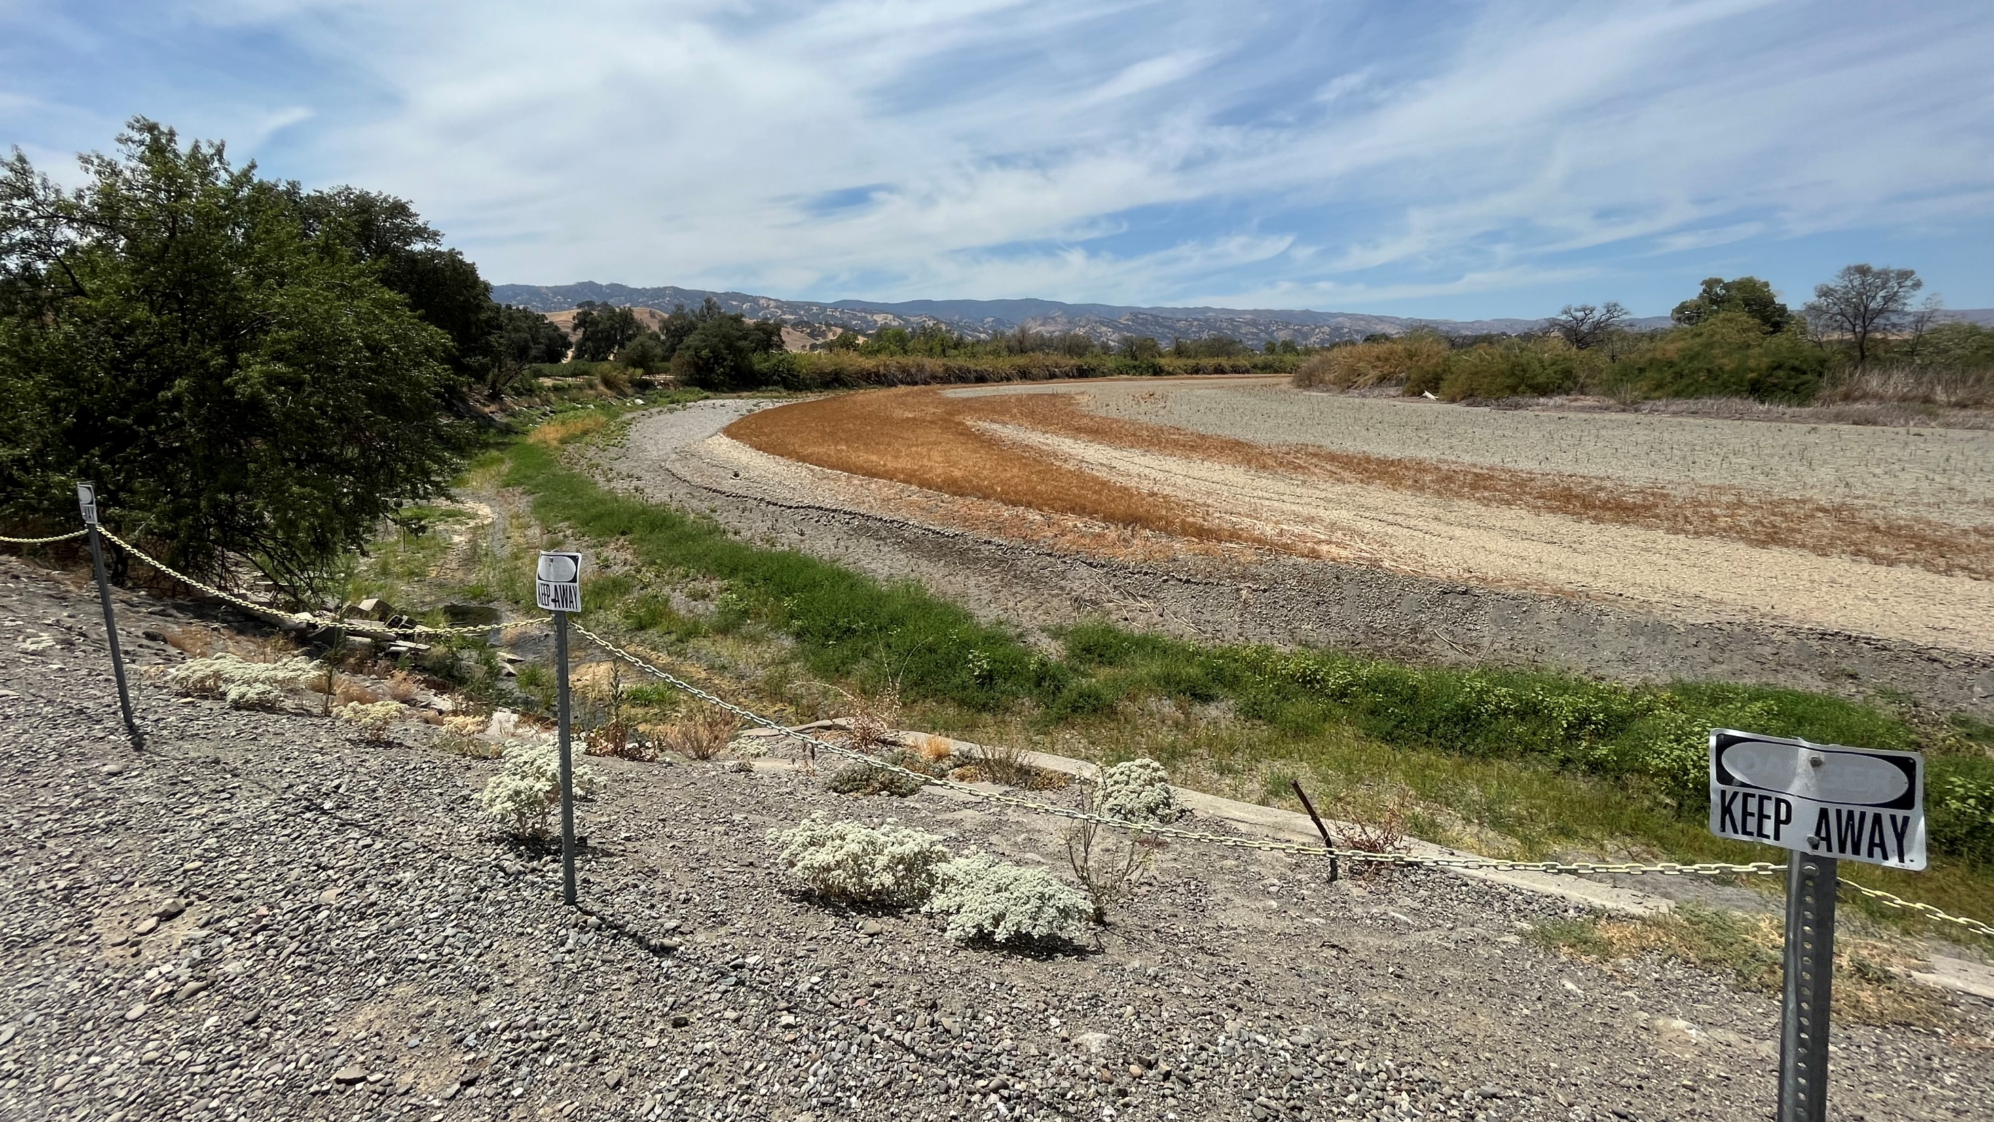

Slide 43
General Activities (November 2-December 6)
PROJECTS:
LWA Cost-of-Service Study and Engineer’s Report for Revenue Restructuring
Drought Assistance – Dry well checks (Contract with Yolo County OES)
Appropriator Water Rights
Indian Valley Reservoir: Cybersecurity Plan
Voluntary Agreement Process/Dry Year Scenario Planning
Training and Initial Phases of Automated Payroll Project and Website Revamping Project
Project Development for Grant Opportunities (Review of Solicitation Packages)
YSGA – Project Development; Outreach; Well Permitting Procedures; GSP Grant Management; Groundwater Monitoring Program Improvements; Grant Opportunities; Neighboring Subbasin Coordination; Grey Area Projects and Outreach
Maintenance on Canal System and Various Private Jobs
Creek Spraying for CCC and Chipper Program for Yolo RCD
Capital Projects – small infrastructure projects and USBR WaterSMART Grant
Weed Management (MERCSA, NDM and Wild Wings CSAs, Madison and Knights Landing CSDs)
Shared Services: Cacheville CSD (part-time GM), SCWA, private jobs, spraying, etc.
Wild Wings CSA and Madison/Knights Landing/Cacheville CSDs Groundwater Assistance and Drought Contingency Planning
Encroachment Permits, Easement Research, Misc. Water Rights Investigations

Slide 44
General Activities (November 2-December 6)
OUTREACH:
VCE / District Coordination Meeting (November 2)
Meeting with County to Discuss Modified Technical Well Procedures (November 2)
Planning for the China Slough Rehabilitation Project (November 8)
DWR’s GSA Forum (November 9)
YSGA Executive Committee Meeting (November 9)
YSGA/YCFB Coordination Meeting (November 9)
Yolo County Financial Oversight Committee Meeting (November 10)
District Focus Group Meeting (November 10)
Sacramento River Basin Coordination Discussion, SGMA Grant Funding (November 10)
Water Data Consortium Cross-Pilot Water Accounting Platform Coordination Meeting (November 14)
Water Resources / Drought Symposium Planning (November 15)
ACWA Region 4 Board Meeting (November 17)
Highway 16 Flooding Solutions Meetings (November 18)
Meeting with Sonoma Water to Discuss Groundwater Recharge Permit Process (November 18)
Meeting with DWR to Discuss Potential VA Contribution (November 21)
YSGA: Board of Directors Meeting (November 21)
ACWA Fall Conference: Groundwater and Water Management Committees, Region 4 Board, and Groundwater Recharge Meeting (Nov. 28-Dec. 1)
Coordination Meeting with TNC and Dunnigan Water District to Prepare for NGO Tour in North Yolo MA (December 2)
Interbasin Coordination Meeting with Solano GSA (December 5)

Slide 45
ysga Update

Slide 46
YSGA 2022 Q4 Activities
GSP 2023 Annual Report
Well Permitting Process: Update on County’s Process
GSP Implementation
Management Area Advisory Committees
Consideration of Revenue Mechanisms
Prioritizing Projects / Preparing Grant Applications
Ad Hoc Drought Task Force Meetings (SB 552: Drought/Water Shortage Planning)
NCWA’s GSA/NGO Tour in North Yolo Management Area (December 8, 2022)
YSGA Board of Directors Meeting
Regular Meeting January 9, 2023

Slide 47
Upcoming Meetings & Events
Preparation for Revenue Assessment Focus Group Meeting (December 7)
NCWA’s GSA/NGO Tour in North Yolo Management Area (December 8)
Yolo OES Dry Well Response Workshop (December 9)
NCWA Groundwater Task Force Meeting (December 12)
Cross-Pilot Water Accounting Platform Coordination Meeting (December 12)
Revenue Re-Evaluation Focus Group Meeting (December 13)
YSGA: Executive Committee Meeting (December 14)
RD 108 Board of Directors Meeting (December 15)
Staff Luncheon (December 21)

Slide 48
Agenda Item #8 General Discussion
Opportunity for Board Members to ask questions for clarification, provide information to staff, request staff to report back on a matter, or direct staff to place a matter on a subsequent agenda.

Slide 49
Agenda Item #9 Payment of Bills Consider the approval and payment of the bills (Checks #61816-61829)

Slide 50
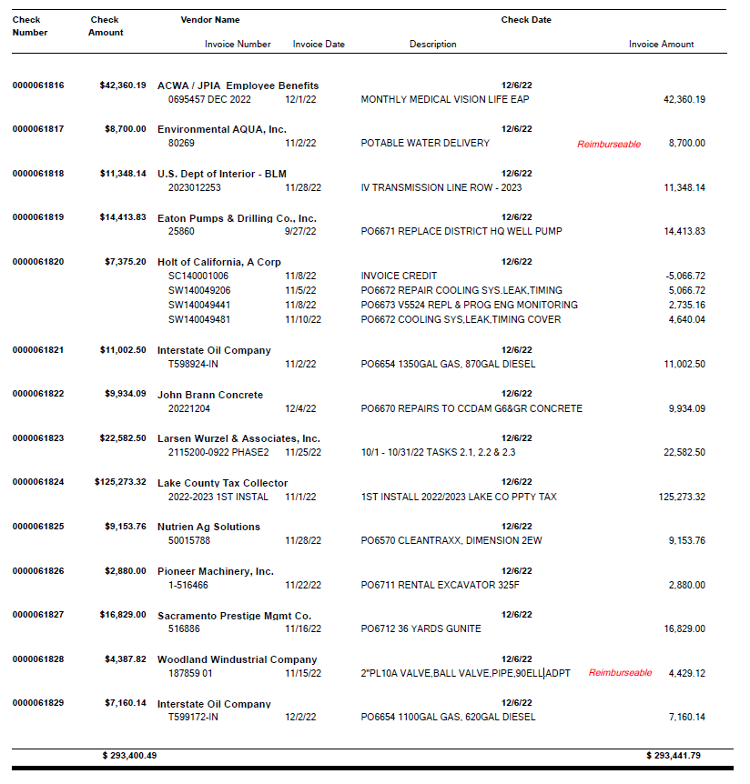

Slide 51
Agenda Item #10 Closed Session: Bay-Delta
Conference with legal counsel for existing administrative proceeding and anticipated litigation/significant exposure to litigation pursuant to Government Code 54956.9, subsections (d)(1) and (d)(2) – State Water Resources Control Board Bay/Delta Plan update proceeding.

Slide 52
Closed Session Report

Slide 53
Agenda Item #11 Adjourn

